Slide 1
medusa node test Rotate Performance under Three states ( LatestHPX )
medusa node:
L1i cache: 32K
L2 cache: 1024K
L3 cache: 28160K
Three status:
Original rotate:
Add split_core function (partition)
Remove unneed asynchronous
NOTE:
1. git log:
commit 4b087d4341b65e4ae8c5fa636a3978c8f45aaa1c (HEAD -> master, origin/master, origin/HEAD)
2.

Slide 2
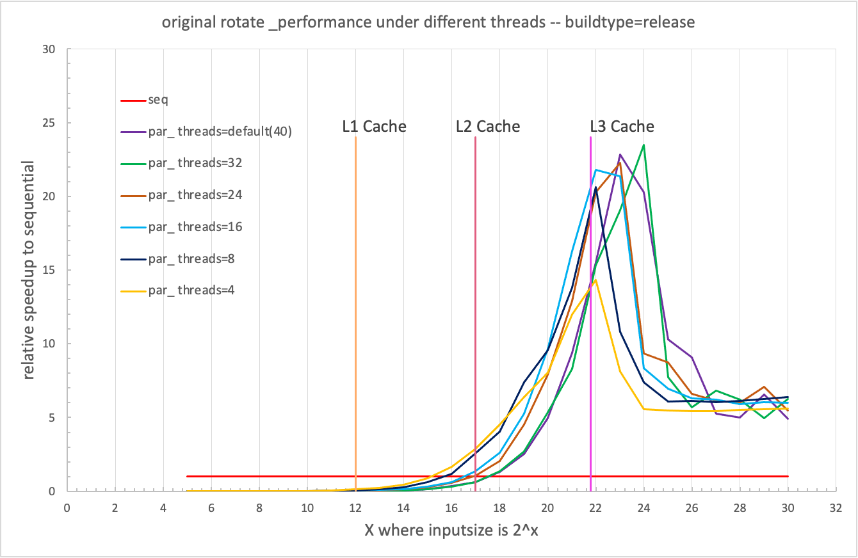

Slide 3
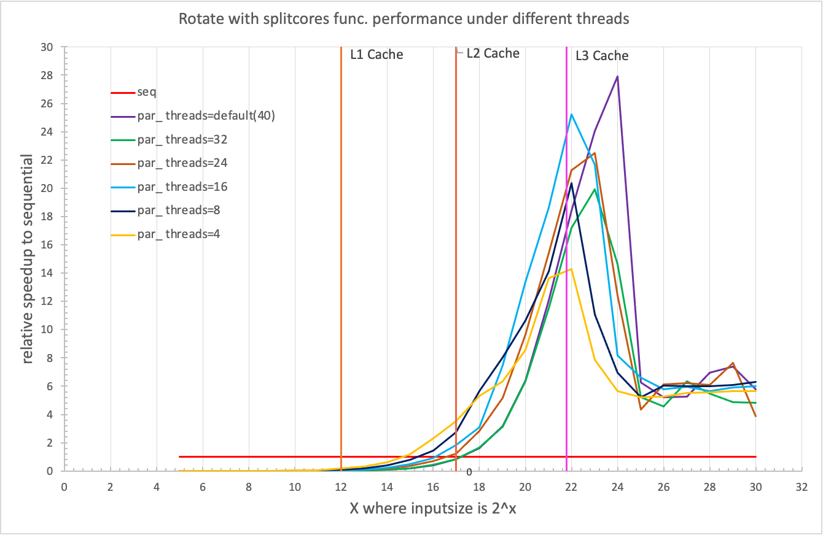

Slide 4
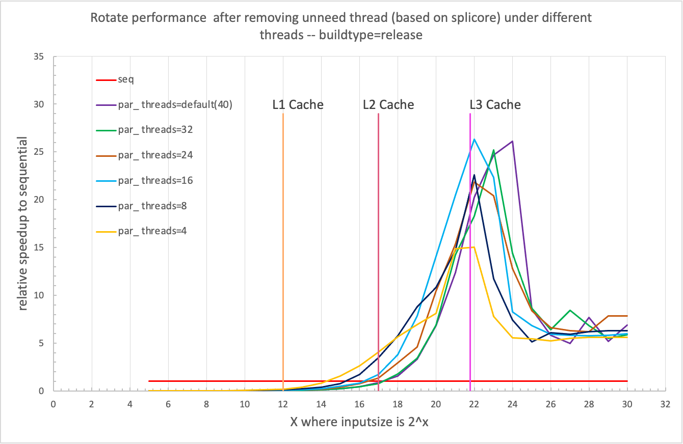

Slide 5
Compare three status under same cores

Slide 12
SUM:
rotate performance got improved after adding partition func. and removing unneed asynchronous thread.
Remaining issue: the improvement under core 4 (8,16) is unreasonable, its too much, but have no idea what’s going on there. Need further exploration.

Slide 13
buran node test Rotate Performance under Three states ( LatestHPX )
buran node:
L1i cache: 32K
L2 cache: 512K
L3 cache: 16384K
Three status:
Original rotate:
Add split_core function (partition)
Remove unneed asynchronous
NOTE:
1. git log:
commit 4b087d4341b65e4ae8c5fa636a3978c8f45aaa1c (HEAD -> master, origin/master, origin/HEAD)

Slide 14
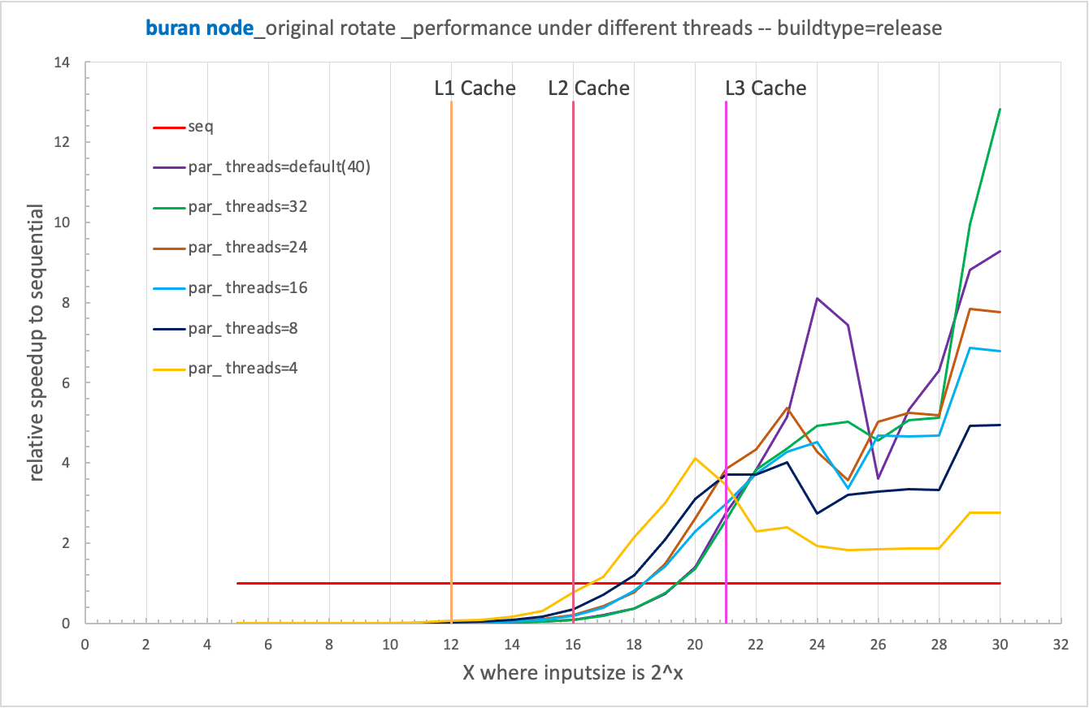
Original rotate

Slide 15
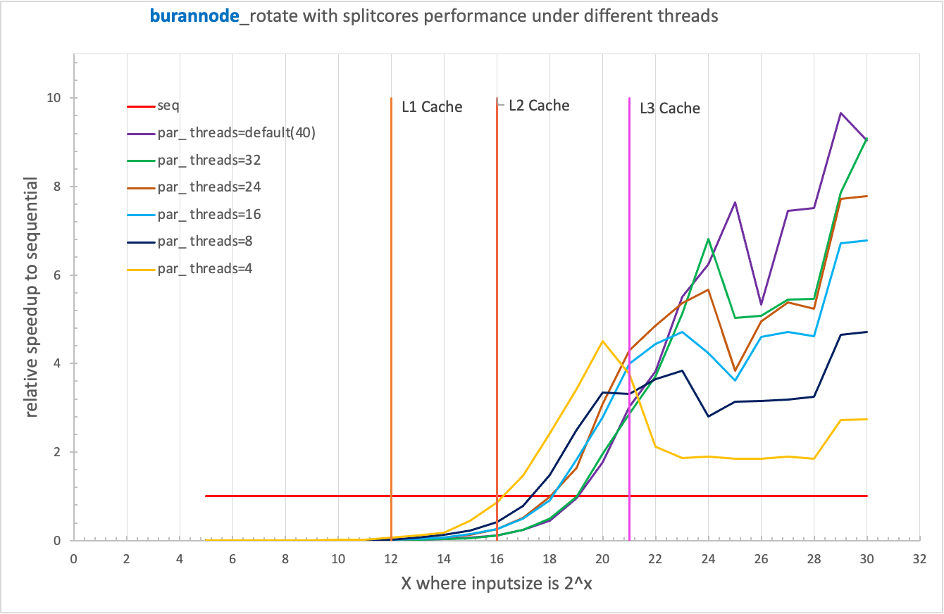
2 Add split_core function (partition)

Slide 16
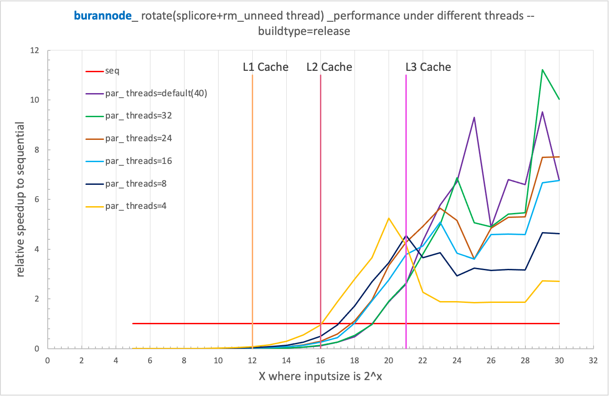
Remove unneeded asynchronous (based on splitcore)

Slide 17
compare results_3states (buran node)

Slide 18
medusa node

Slide 19
medusa node

Slide 20
medusa node

Slide 21
medusa node

Slide 22
medusa node

Slide 23
medusa node

